Slide 1
Session : Data Structures
Session Speaker :
Syed Hazeera
hazeeraece@gmail.com

Slide 2
Session Objectives
To understand about stacks and linked list

Slide 3
Data Structure
Data structure is a method of storing data in a computer so that it can be used efficiently.
• Data structure is further classified into
Linear- data elements are stored in sequential order.
Eg: Arrays, Stacks, Queues, Linked lists
Non-linear –data elements which are not stored in sequential manner. Eg:Trees, Graphs

Slide 4
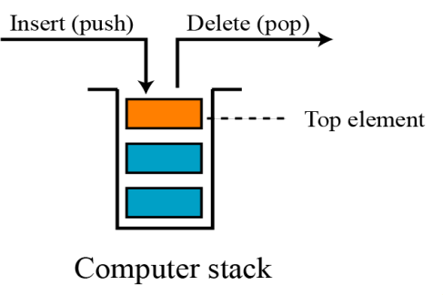
STACKS
A stack is a special type of data structure where elements are inserted from one end and elements are deleted from the same end.
The position where elements are inserted and deleted is called top of stack
Hence, stack is also called Last In First Out (LIFO)

Slide 5
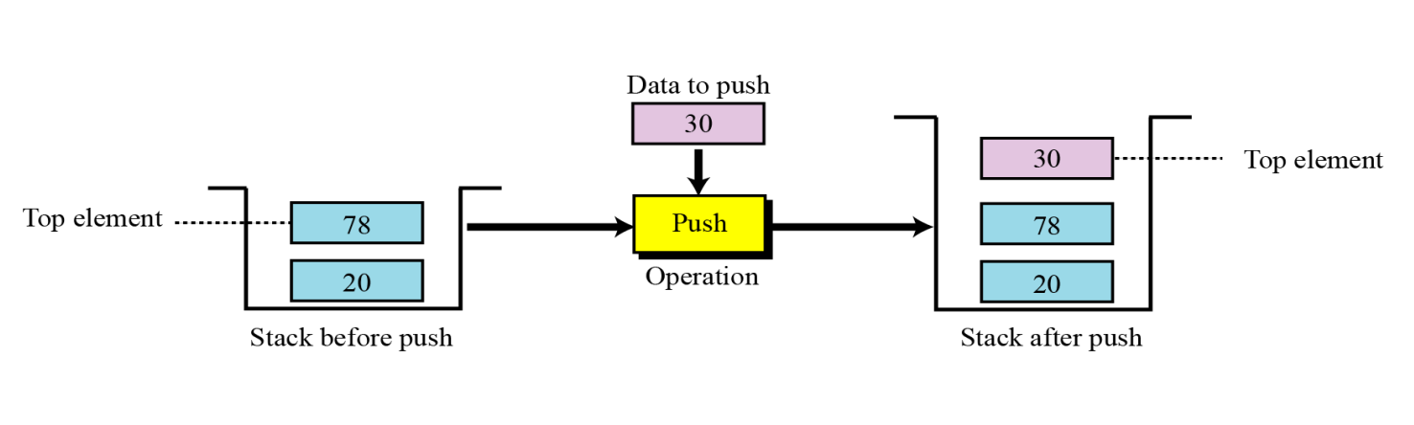
Operations on stacks
There are three basic operations:-
1. Push Operation - inserts an item at the top of the stack
Example:
void push()//using global variables
{
if(top==STACK_SIZE-1)
{
printf(“stack overflow\n”);
return;
}
top=top+1;
s[top]=item;
}

Slide 6
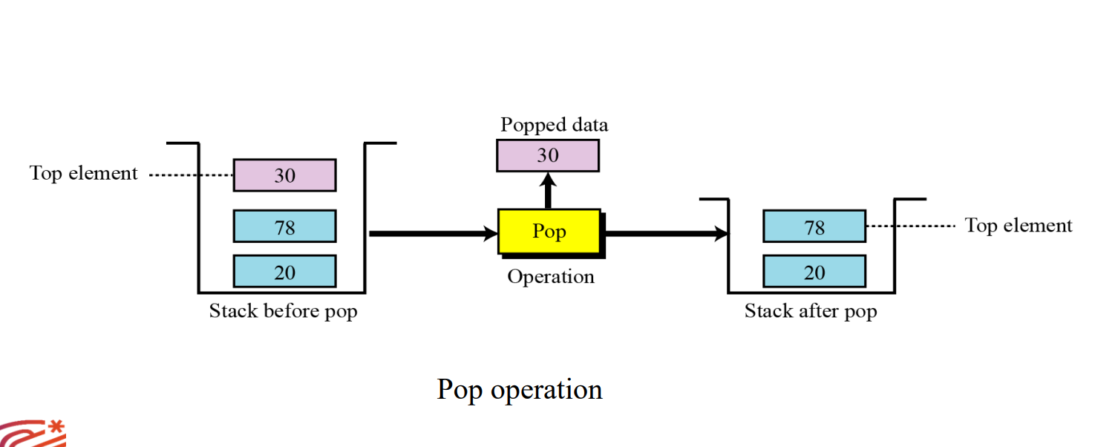
Operations on stacks
2. Pop Operation - deletes the item at the top of the stack.
Example:
int pop()//using global variables
{
int item_deleted ;
if(top==-1)
{
printf(“stack is empty\n”);
return 0;//stack underflow
}
item_deleted=s[top--];
return item_deleted;
}

Slide 7
Operations on stacks
3. Display Operation - Displays elements in the stack
Example :
void display()
{
int i;
if(top==-1)
{
printf(“stack is empty”);
}
printf(“contents of the stack”);
for(i=0;i<=top;i++)
printf(“%d\n”,s[i]);
}

Slide 8
Stack applications
Stack applications can be classified into four broad categories: –
Conversion of expression
Evaluation of expression
Recursion
Reverse string
• Representation of expressions
Infix expression – e.g. a+b
Postfix expression-e.g. ab+
Prefix expression-e.g. +a

Slide 9
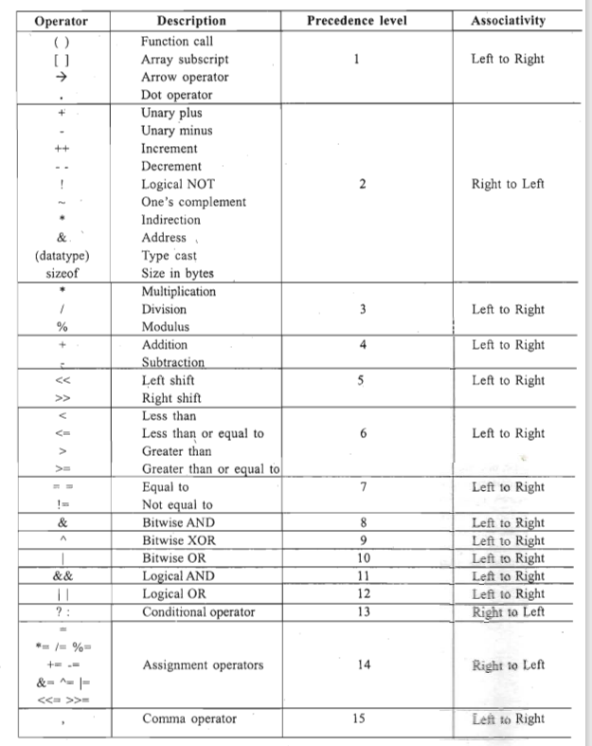

Slide 10
Infix to postfix conversion
Rules :
Read all the symbols one by one from left to right in the given Infix Expression.
If the reading symbol is operand, then directly print it to the result (Output).
If the reading symbol is left parenthesis '(', then Push it on to the Stack.
If the reading symbol is right parenthesis ')', then Pop all the contents of stack until respective left parenthesis is popped and print each popped symbol to the result.
If the reading symbol is operator (+ , - , * , / etc.,), then Push it on to the Stack. However, first pop the operators which are already on the stack that have higher or equal precedence than current operator and print them to the result.

Slide 11
Infix to postfix conversion
Infix expression
Postfix expression
(a+b-c)*d-(e+f)
a+b-c)* d-(e+f)
+b-c)* d-(e+f)
b-c)* d-(e+f)
-c)* d-(e+f)
b-c)* d-(e+f)
) * d – ( e + f )
* d – ( e + f )
d – ( e + f )
– ( e + f )
( e + f )
e + f )
+ f )
f )
)
a
a
a b
a b +
a b + c
a b + c –
a b + c –
a b + c – d
a b + c – d *
a b + c – d *
a b + c – d * e
a b + c – d * e
a b + c – d * e f
a b + c – d * e f +

Slide 12
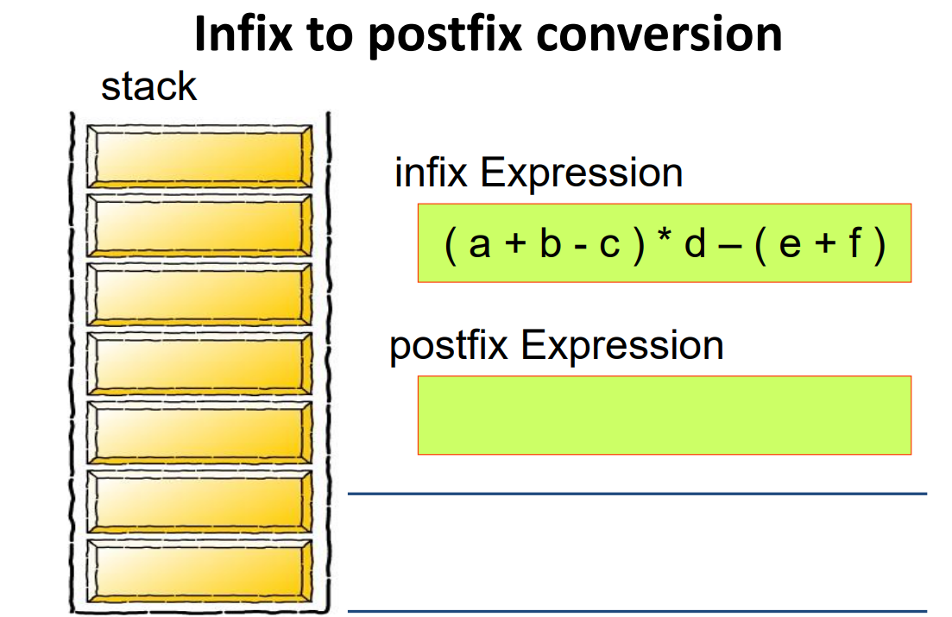
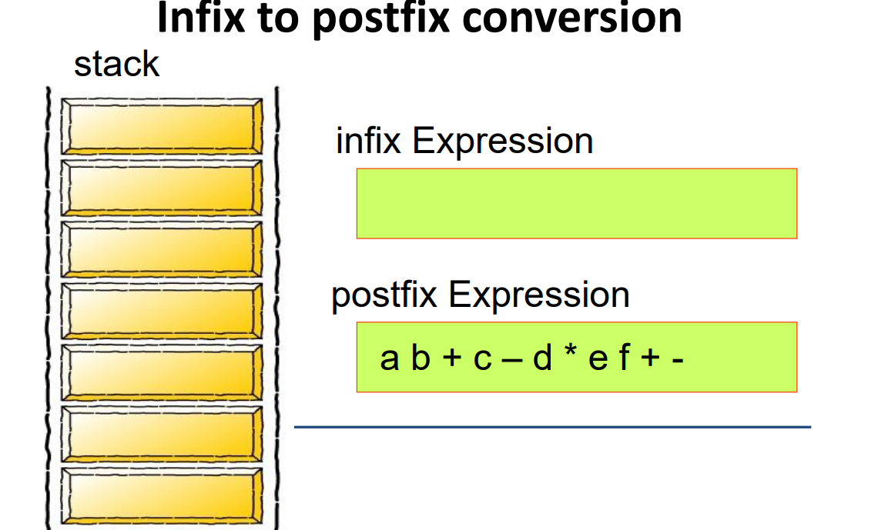
Infix to postfix conversion

Slide 13
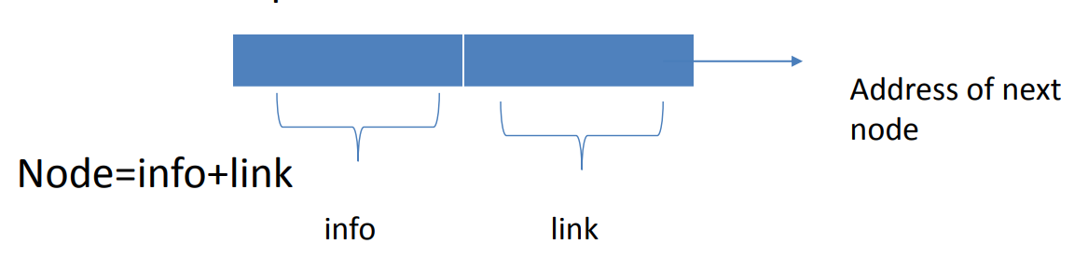
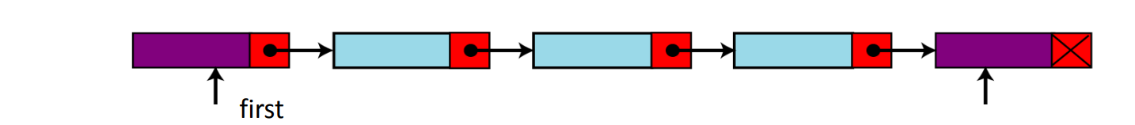
Linked Lists
As Array items are stored contiguously, if the input data is changing dynamically then we need linked list to do the operations.
Linked List is data structure which is collection of zero or more nodes where each node has some information and address of next node.
A linked list can grow or shrink in size as the program runs.
The last node points to NULL.

Slide 14
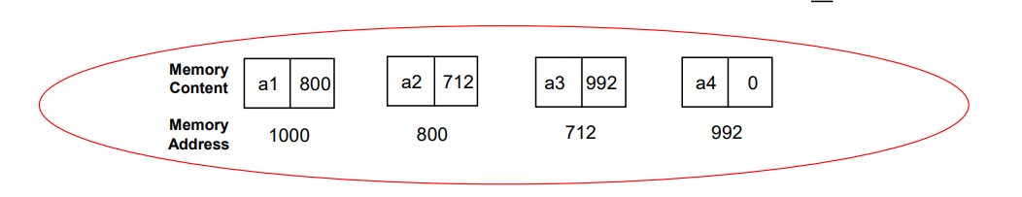
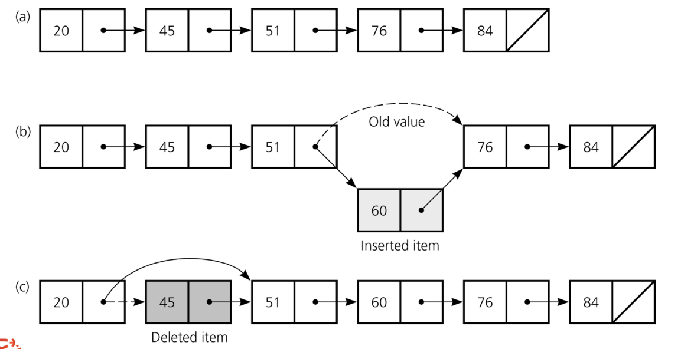
Types of linked list
Two types :-1.single linked list and 2.double linked list.

Slide 15
Advantages of linked list
length of a list can increase or decrease as necessary.
When the number of data elements to be represented in the data structure is unpredictable.
Provides better memory utilization.

Slide 16
Applications
Arithmetic operations on long positive numbers
Manipulation of polynomials
Evaluation of polynomials
In symbol table construction
Image viewer-previous and next images are linked.
Web browsers and music players
Double linked list – used in navigation system where both front and back navigation is required.
Represent deck of cards in a game and states of a game.

Slide 17
Defining node
Each node has two fields info and link both are different data type.
Syntax:
Struct node
{
Type1 info;
Type2 *link;
};
Eg: Struct node
{
int info;
struct node *link;
};
typedef struct node *NODE;//alias name

Slide 18
Operations on single linked list
Creation of list.
Inserting a node in the beginning.
Inserting a node in between or at the end.
Deletion of first node
Deletion of node in between or at end
Search in a list
Display the contents of list/traversal of list
Reversal of list

Slide 19
Creation of list.
Creation of list: Insert an element at the end of list, we will allocate memory for a node as
tmp = malloc(sizeof(struct node));
tmp->info = data;
tmp->link = NULL;
If the list is empty and we are inserting the first element, then we'll have to initialize the pointers as
if ( start = = NULL) /*If list is empty */
start ==tmp
we'll keep on inserting new nodes at the end of the list.

Slide 20
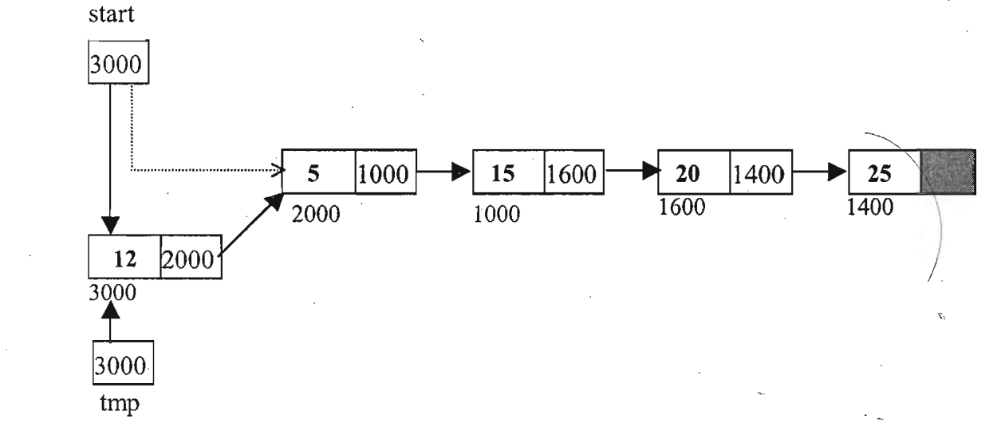
Inserting a node in the beginning.
Inserting Front: To insert a node, initially we'll dynamically allocate space for that node using malloc( ).
tmp = (struct node *)malloc( sizeof(struct node) );
tmp->info = data;
tmp->link = start;
start = tmp

Slide 21
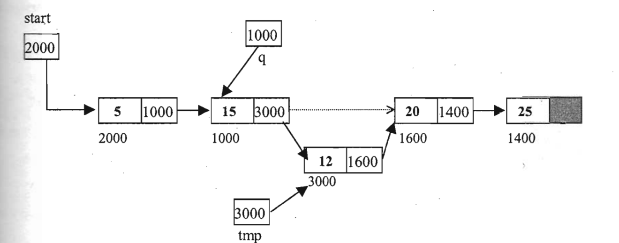
Insertion in Between or at the end
Insertion in between : we give the link part of that node to the link part of inserted node and address of the inserted node is placed into the link part of the previous node.
tmp->link = q->link;
q->link = tmp;
Insertion at end: q->link will be NULL

Slide 22
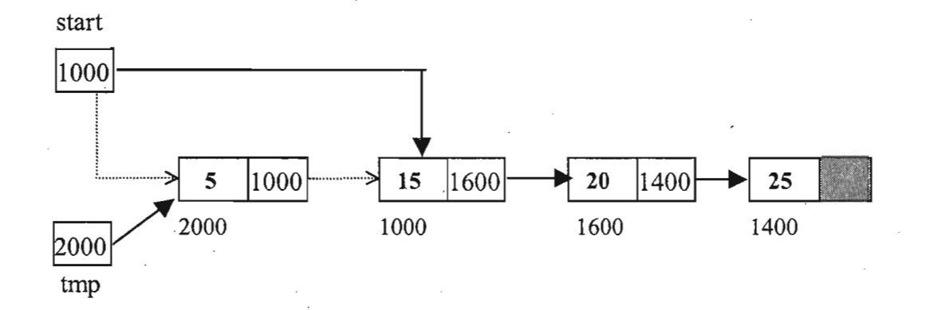
Deletion of first node
Deletion of first node:To release memory we'll use the function free() ,We'll take a pointer tmp that will point to the node to be deleted and after deletion of the node as free(tmp).
the node to be deleted is the first node hence tmp will be assigned the address of first node.
tmp = start;
(start->link will point to the
second node of link list. )
start = start->link;
free( tmp );
(free the element to be deleted)

Slide 23
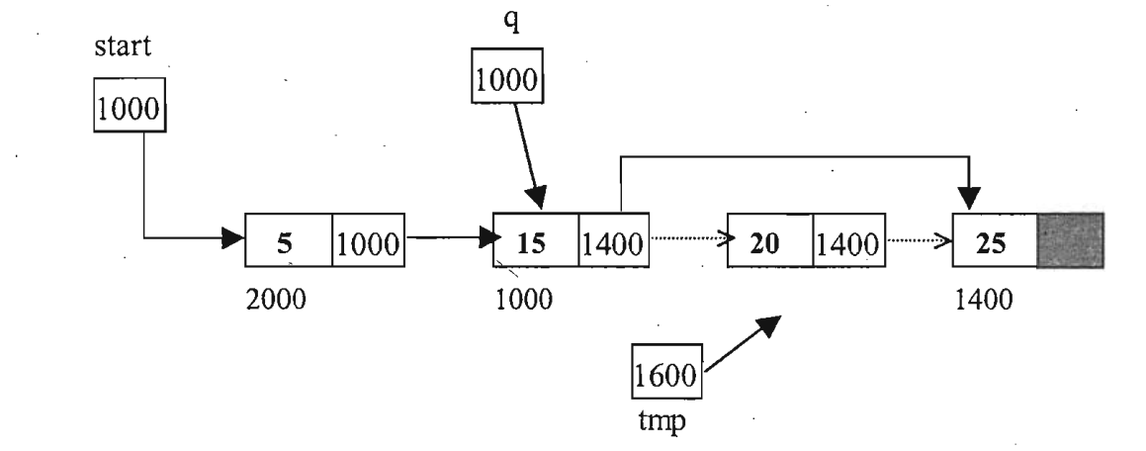
Deletion of a node in between or at the end
Deletion of a node in between : the node to be deleted will be pointed by q->link
tmp = q->link;
Assign the link part of the node to be deleted to the link part of the previous node.
q->link = tmp->link;
free(tmp);
Deletion at end: node to be deleted is last node of linked list.
q->link = NULL;

Slide 24
Display the contents of list/traversal of list
Traversal of a list means accessing each node exactly once, we'll take a structure pointer ptr.
ptr = start;
ptr points to the first node of linked list, We can access the info part of first node by writing
ptr = ptr->link;
traverse each element of linked list, until ptr has NULL value.
while(ptr!=NULL)
{
printf ("%d ", ptr->info) ;
ptr = ptr->link;
}

Slide 25
Search in a list
Searching in a linked list: For searching an element, we traverse the linked list and while traversing we compare the info part of each element with the given element.
while(ptr!=NULL)
{
if=(ptr->info==data) /*Search successful*/
else
ptr=ptr->link; /*Go to next element* /
}

Slide 26
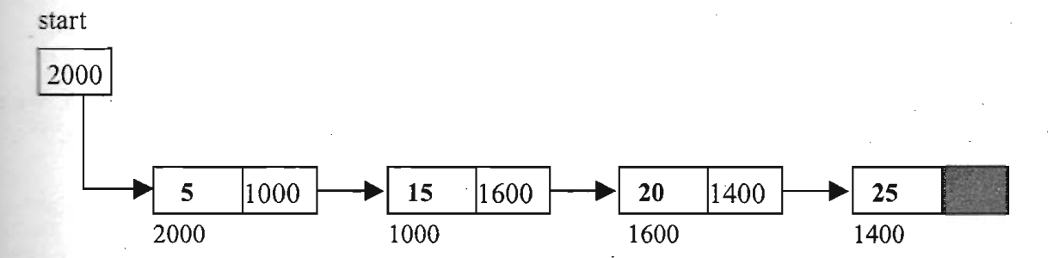
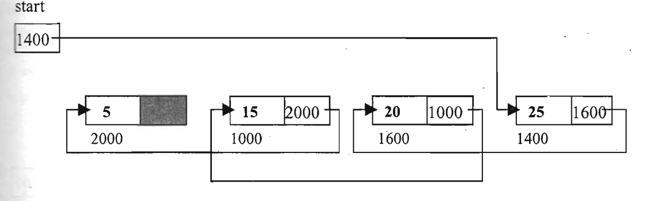
Reversal of list
Reversing the linked list:
Reassigning all the next properties ,on every node.
first node will become the last node of linked list.
last node will become the first node of linked list and now start will point to it.
Link of 2nd node will point to 1st node, link of 3'd node will point to second node and' so on.
Link of last node will point to the previous node of last node in linked list.

Slide 27
#include <stdio.h>
#include <malloc.h>
#include<stdlib.h>
struct node
{
int info;
struct node *link;
}*start;
void create_list(int data);
void addatbeg(int data);
void addafter(int data,int pos);
void del(int data);
void search(int data);
void display();
void del(int data);
int main()
{
int choice,n,m,position,i,tmp;
while(1)
{
printf (" 1.Create List \n") ;
printf("2.Add at begining\n");
printf ("3.Add after \n");
printf("4.Delete\n");
printf("5.Display\n");
printf("6.Search\n") ;
printf("7.Quit\n") ;
printf ("Enter your choice ") ;
scanf("%d",&choice);
switch(choice)
{
case 1:
start=NULL;
printf ("How many nodes you want ") ;
scanf ( "%d" , &n) ;
for(i=0;i<n;i++)
{
printf("Enter the element :");
scanf("%d",&m);
create_list(m);
}
break;
case 2:
printf ("Enter the element : ");
scanf ("%d" ,&m);
addatbeg(m);
break;
case 3:
printf ("Enter the element: ");
scanf ("%d" ,&m);
printf ("Enter the position after which this element is to be inserted ");
scanf("%d",&position);
addafter(m,position);
break;
case 4:
if(start==NULL)
{
printf ("List is empty\n");
continue;
}
printf ("Enter the element for deletion:");
scanf ("%d" ,&m);
del(m);
break;
case 5:
display();
break;
case 6:
printf("Enter the element to be searched :");
scanf("%d", &m);
search(m);
break;
case 7:
exit(0);
default:
printf ("Wrong choice\n");
}/*End of switch*/
}/*End of while*/
}/*End of main() */
void create_list(int data)
{
struct node *q, *tmp;
tmp=malloc(sizeof(struct node));
tmp->info=data;
tmp->link=NULL;
if (start==NULL) // * If list is empty* /
start=tmp;
else
{
/*Element inserted at the end*/
q=start;
while(q->link!=NULL)
q=q->link;
q->link=tmp;
}
}
void addatbeg(int data)
{
struct node *tmp;
tmp=malloc(sizeof(struct node));
tmp->info=data;
tmp->link=start;
start = tmp;
}
void del(int data)
{
struct node *tmp, *q;
if(start->info==data)
{
tmp=start,
start=start->link;//*First element deleted*1
free (tmp);
return;
}
q=start;
while(q->link->link!=NULL)
{
if(q->link->info==data)//*Element deleted in between*1
{
tmp=q->link;
q->link=tmp->link;
free(tmp);
return;
}
q=q->link;
}
if (q->link->info==data) //*Last element deleted* /
{
tmp=q->link;
free(tmp) ;
q->link=NULL;
return;
}
printf ("Element %d not found\n", data) ;
}/*End of del( )*/
void display()
{
struct node *q;
if(start==NULL)
{
printf ("List is empty\n");
return;
}
q=start;
printf("List is : \n");
while(q!=NULL)
{
printf("%d ", q->info);
q=q->link;
}
printf (" \n") ;
} //*End of display ( * /
void addafter(int data,int pos)
{
struct node *tmp, *q;
int i;
q=start;
for(i=0;i<pos-1;i++)
{
q=q->link;
if(q==NULL)
{
printf("There are less than %d elements", pos);
return;
}
}
tmp = malloc(sizeof(struct node));
tmp->link=q->link;
tmp->info=data;
q->link=tmp;
}
void search(int data)
{
struct node *ptr=start;
int pos=1;
while(ptr!=NULL)
{
if (ptr->info==data)
{
printf("Item %d found at position %d\n",data,pos);
return;
}
ptr=ptr->link;
pos++;
}
if (ptr==NULL)
printf("Item %d not found in list\n", data);
}

Slide 28
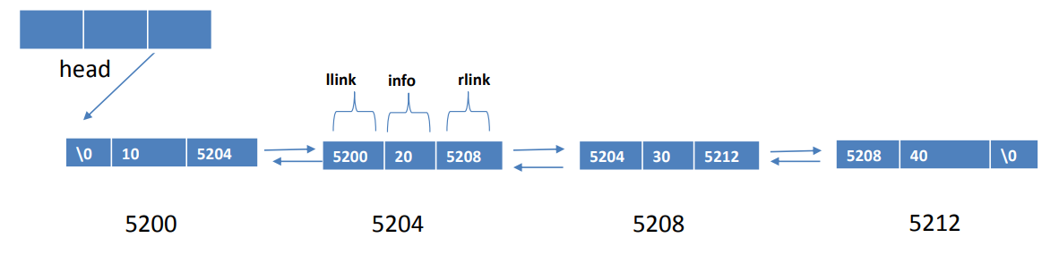
Double linked list
It is linear collection of nodes where each node consists of
– info-information is stored
– llink-pointer field holds the address of left node ( i.e previous node)
– rlink-pointer field holds the address of right node(i.e next node in list)

Slide 29
Operation on doubly link list
Inserting a node
Deleting a node
Display info
Struct node
{
int info;
struct node *llink;
struct node *rlink;
};
typedef struct node *NODE; //alias name

Slide 30
Inserting node
NODE insert_front(int item,NODE head)
{
NODE temp,cur;
temp=getnode();
temp->info=item;
cur=head->rlink;
head->rlink=temp;
temp->rlink=cur;
return head;
}

Slide 31
Deleting node
NODE delete_front(NODE head)
{
NODE cur,next;
if(head->rlink==NULL)
{
printf(“list is empty\n”);
return head;
}
cur=head->rlink;//obtain the first node
next=cur->rlink;//obtain the second node
head->rlink=next;
printf(“node deleted is %d”,cur->info);
freenode(cur);//delete the first node
return head;
}

Slide 32
display
Void display(NODE head)
{
NODE temp;
if(head->rlink==NULL)
{
printf(“list is empty”);
return;
}
printf(“contents of list”);
temp=head->rlink;
while(temp!=NULL)
{
printf(“%d”,temp->info);
temp=temp->rlink;
}
}

Slide 33
//c program for double linked list
#include<stdio.h>
#include<stdlib.h>
struct node
{
int info;
struct dnode*llink;
struct dnode*rlink;
};
typedef struct node* NODE;
NODE head;
NODE getnode()
{
NODE x;
x= (NODE)malloc(sizeof(struct node));
if(x== NULL)
{
printf("out of memory");
return;
}
return(x);
}
void freenode(NODE x)
{
free(x);
}
NODE insert_front(int item,NODE head)
{
NODE temp,cur;
temp = getnode();
temp->info=item;
cur = head->rlink;
head->rlink = temp;
temp->rlink=cur;
return head;
}
NODE delete_front(NODE head)
{
NODE cur,next;
if(head->rlink == NULL)
{
printf("list is empty\n");
return(head);
}
cur= head->rlink;
next = cur->rlink;
head->rlink = next;
printf("node deleted is %d",cur->info);
freenode(cur);
return(head);
}
void display_front(NODE head)
{
NODE temp;
if(head->rlink == NULL)
{
printf("list is empty");
return;
}
printf("contents of list :\n");
temp = head->rlink;
while(temp!=NULL)
{
printf("%d\n",temp->info);
temp = temp->rlink;
}
}
void display_rear(NODE head)
{
NODE temp;
if(head->rlink == NULL)
{
printf("list is empty\n");
}
temp = head;
while(temp->rlink == NULL)
temp = temp->rlink;
while(temp!=NULL)
{
printf("%d\n",temp->info);
temp = temp->rlink;
}
}
main()
{
NODE temp;
int list,item;
head = getnode();
head->link = NULL;
for(;;)
printf("operations on double linked list:\n");
printf("1.inserting at front\n 2.deleting at front\n 3. display at front\n 4.display at rear\n");
printf("enter your choice:\n");
scanf("%d",&list);
switch(list)
{
case1:
printf("insert item at front");
scanf("%d",&item);
insert_front(int item,NODE head);
break;
case 2:
printf("delete item at front");
scanf("%d",&item);
delete_front(NODE head);
break;
case 3:
display_front(NODE head);
break;
case 4:
display_rear(NODE head);
break;
case 5:
exit(0);
default:
printf ("Wrong choice\n");
}
}

Slide 34
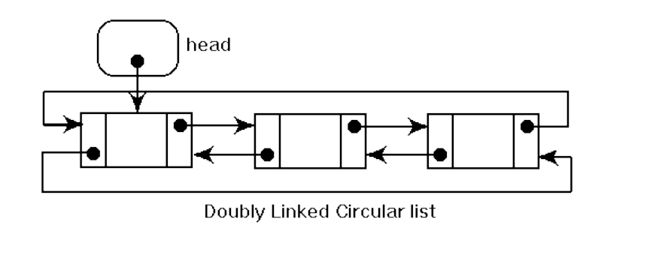
Circular Doubly Linked List
Circular doubly Linked List is a variation of Linked list in which the first element points to the last element and the last element points to the first element.

